Slide 1
Working memory (reward & punishment)

Slide 2
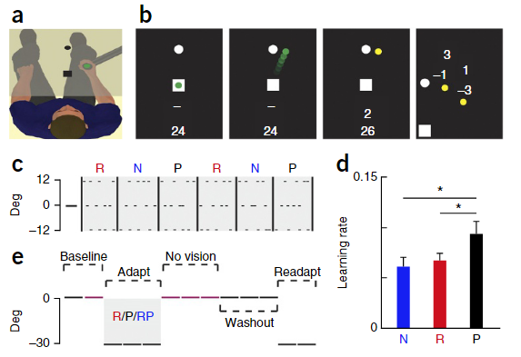
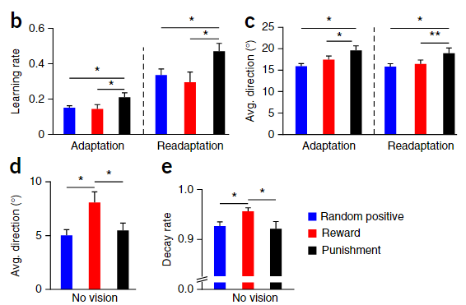
Punishment enhanced learning during randomly alternating visuomotor rotations.
Punishment led to faster learning but reward caused greater memory retention.

Slide 3
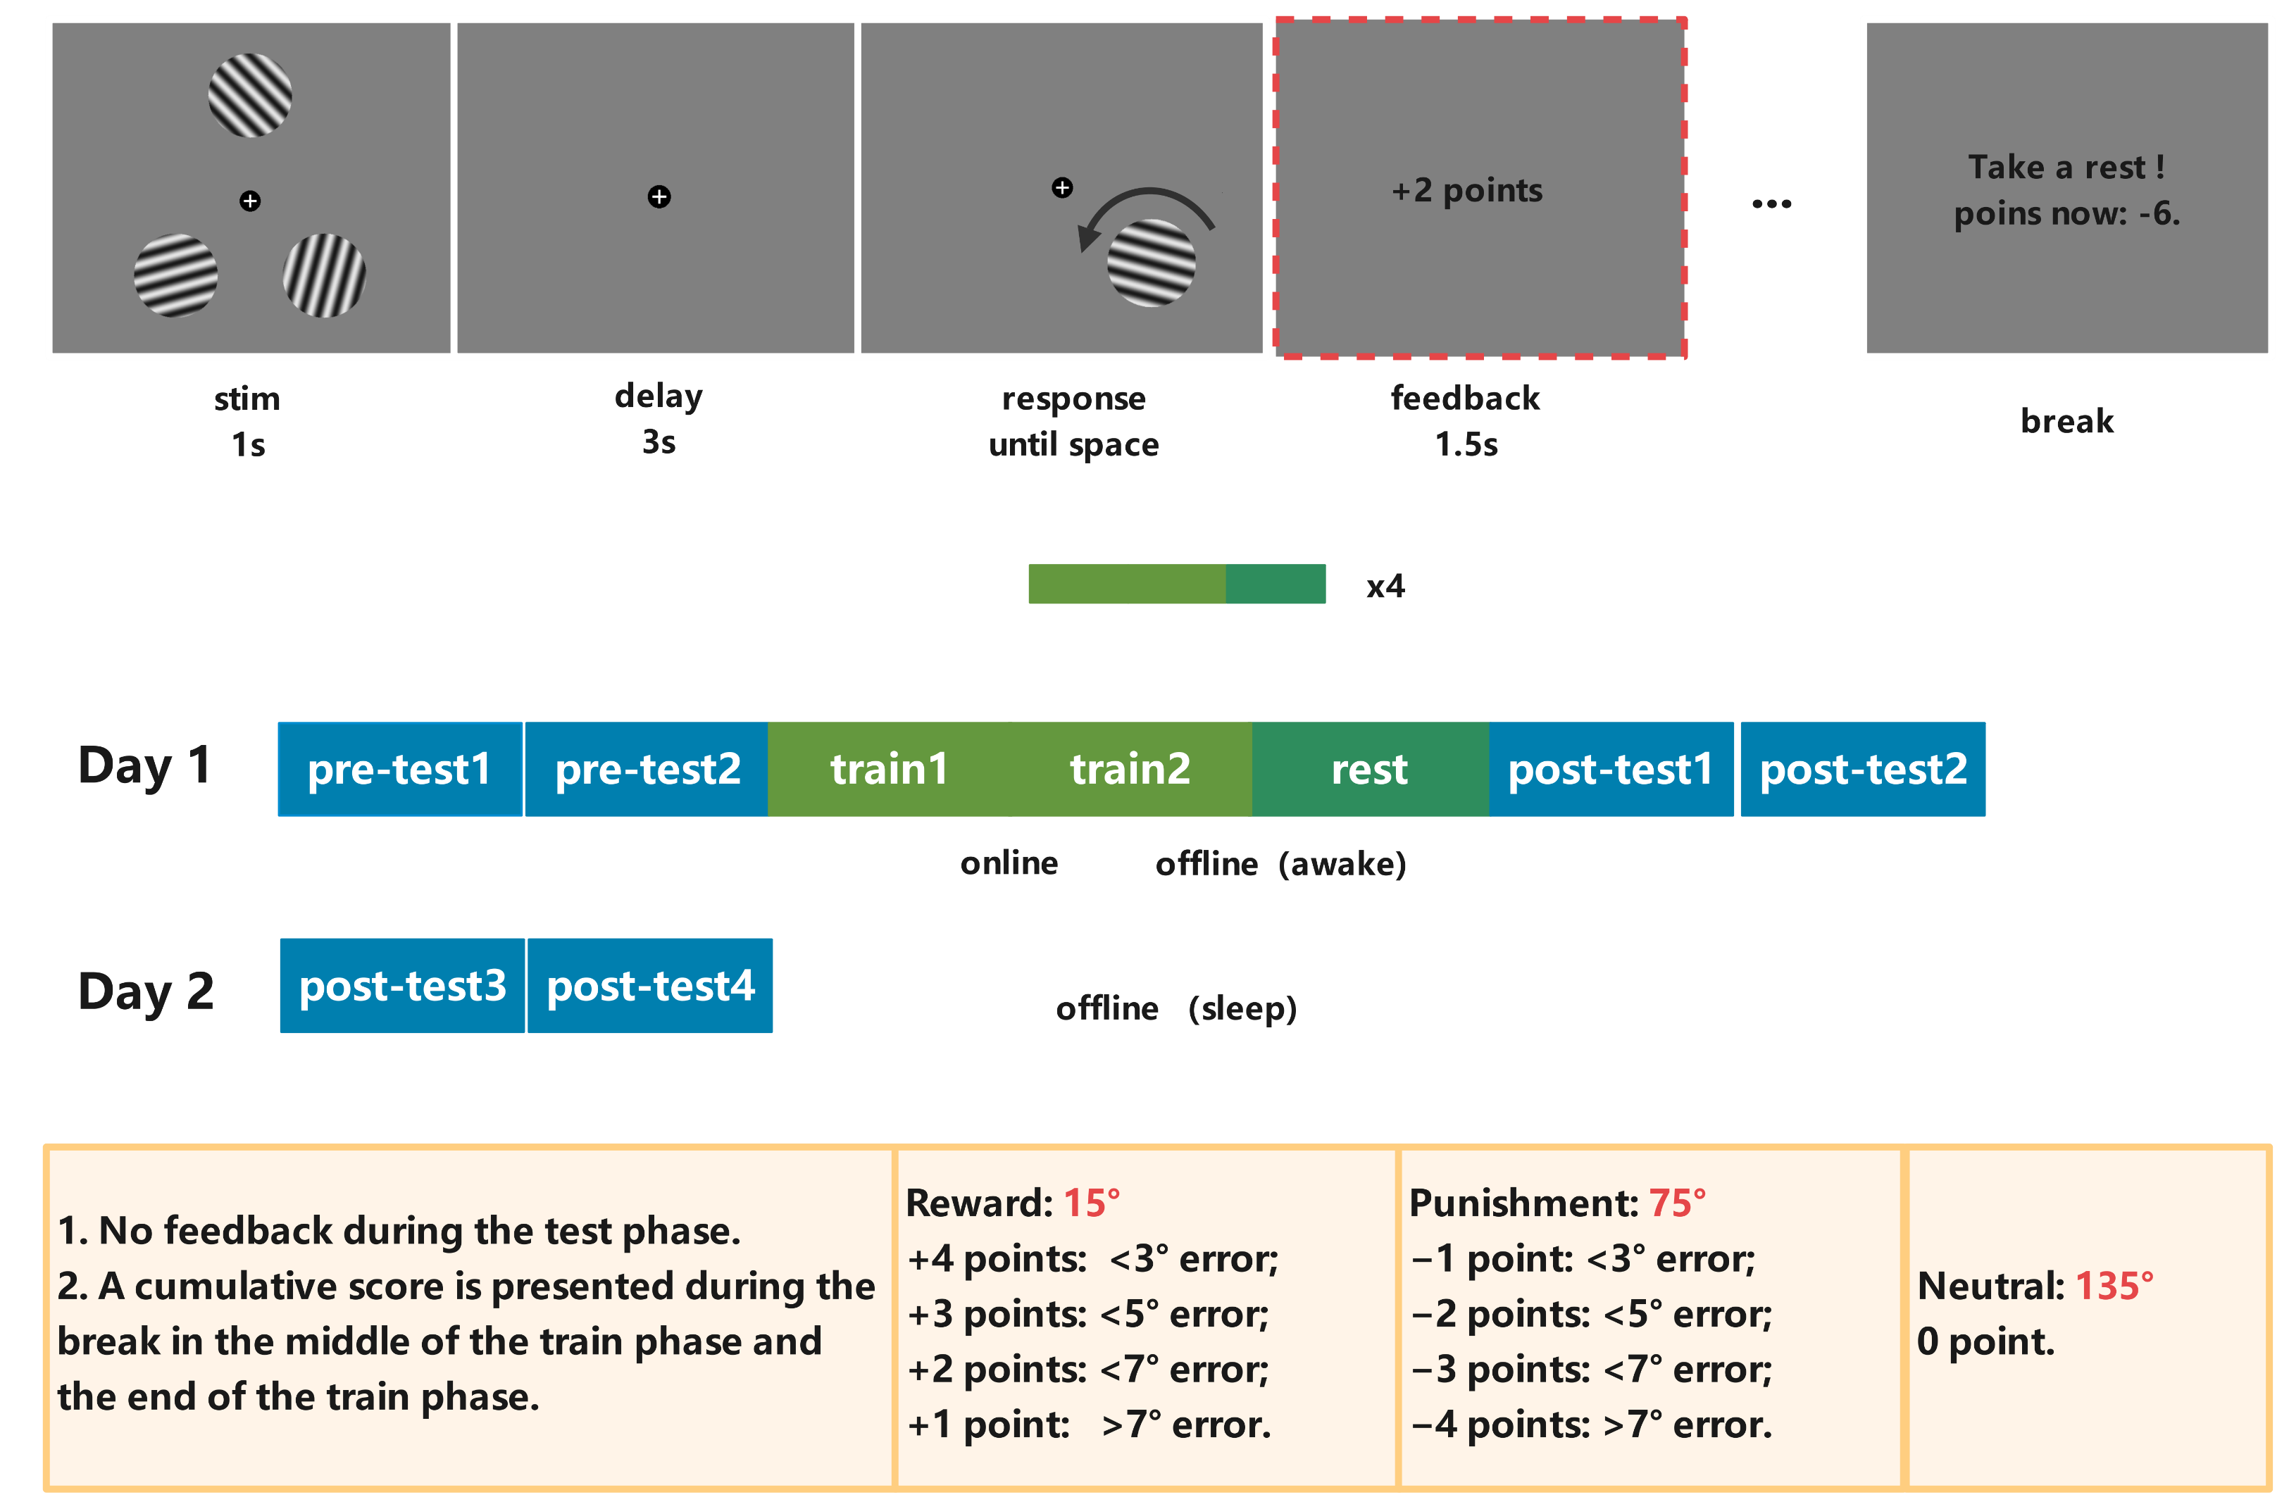
Notes:
去掉test,对比每天的训练
一个被试3天，一天90min，delay =1.5, feedback=1

Slide 4
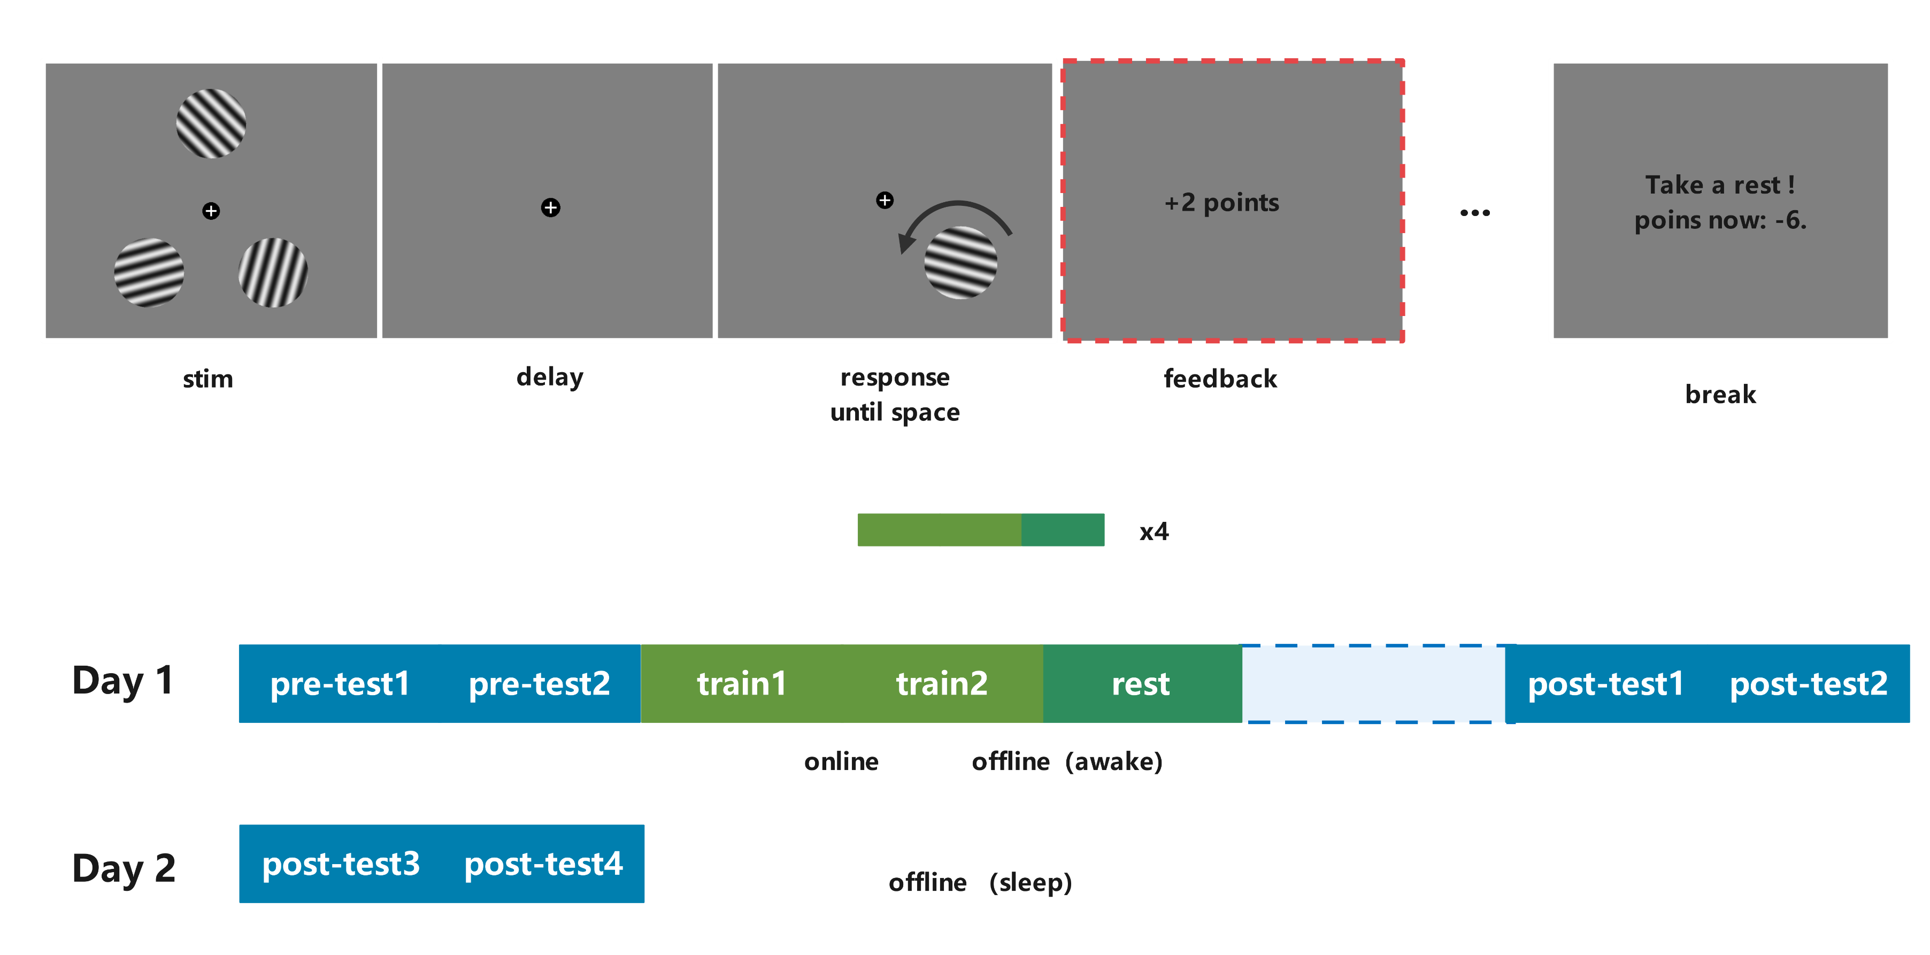

Slide 5
（待）解决问题
Stim_dur: 0.5s → 1s
Num_participants: > 20
Num_trials: test = 90+90, train = (75+75)*4
75 = 25*3
每个condition=25*4=100trials
Interval before post-test during day1:10min

Slide 6
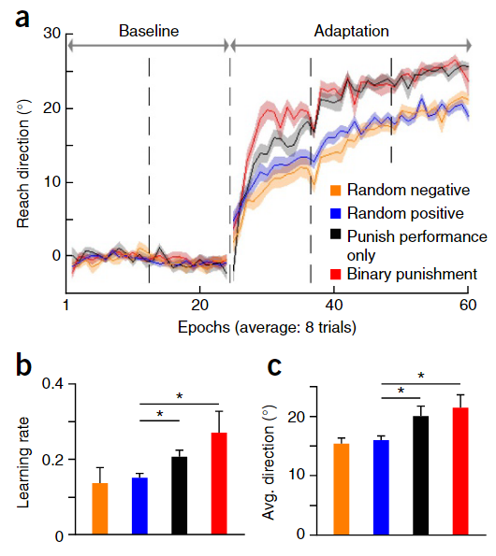
Binary punishment. It is possible that the graded feedback provided dur-ing punishment acted as an additional error signal, which enhanced the rateof motor-based learning. Although this cannot explain the difference between punishment and reward, we decided to run a control group (n = 8) in which participants received binary punishment feedback during adaptation. Participants were told that they would receive 0 points for hitting the target (±5°) and −1 for any error above this value. Each negative point was related to losing 1 pence, with participants beginning with £8. Note that for all remaining control groups, only the two baseline blocks and adaptation were tested.
Random negative. The random positive group in experiment 2 involved random but positive points. It is possible that even though these positive points were unrelated to performance, they could still be implicitly rewarding to the participant. Therefore, a control group (n = 8) was exposed to random but negative points (random negative) during adaptation. If the sign (positive or negative)of the points was important, rather than them being related to performance or money, then this random negative group should show significantly faster learning during adaptation.

Slide 7
Following step: control group
Group A: Random positive / negative number.
Group B: Binary punishment.

Slide 8
Hypothesis
Day 1 post-test : Punished > Rewarded > Neutral;
Day2 post-test : Rewarded > Punished > Neutral;
Day1 training : Online(Punished) > Online (Rewarded);
Day1 training : Online(Train2_Punishmed) > Online(Train1_Punishmed);
Day1 training : Offline(Rewarded) > Offline (Punished);
Day1 training : Offline(Train3_ Rewarded) > Online(Train2_ Rewarded);

